Slide 1


FINAL PROJECT
Information Technology encompasses hardware, softerware, networking, data management, and cyber security to manage and process information, driving efficiency and innovation across industries.

Slide 2
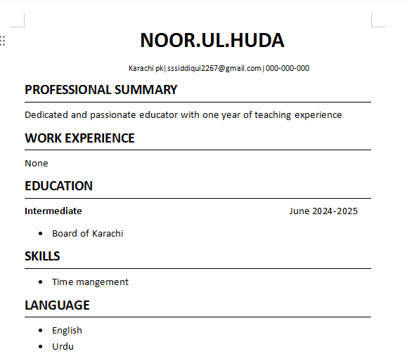
My Resume
A dedicated and detail-oriented Computer Science student with a solid understanding of programming concepts learned through relevant coursework. Seeking an entry-level role where I can apply and expand my skills in Java and problem-solving, contributing fresh ideas in a collaborative environment.

Slide 3
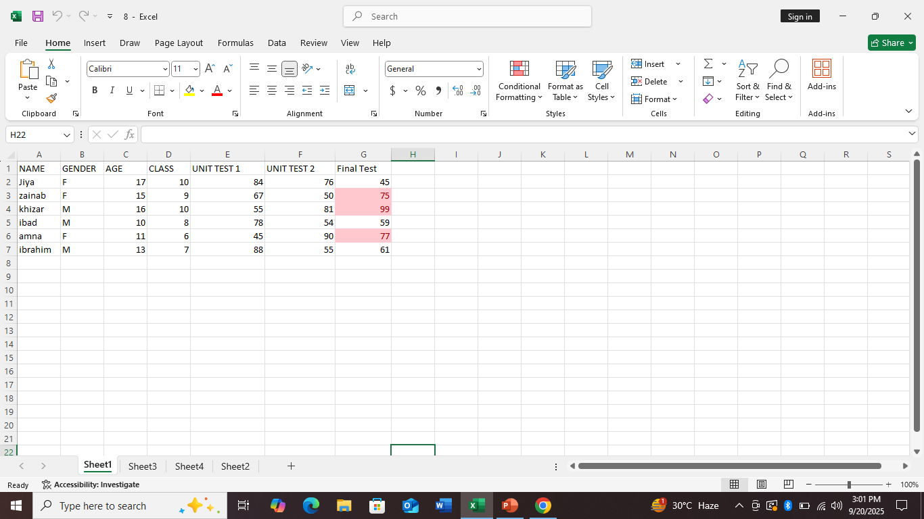
Conditional formatting
Conditional formatting is used to apply formatting such as changing colors, fonts, or adding icons to cells based on specific rules.
.
A deeper investigation may be warranted to determine the underlying causes.

Slide 4


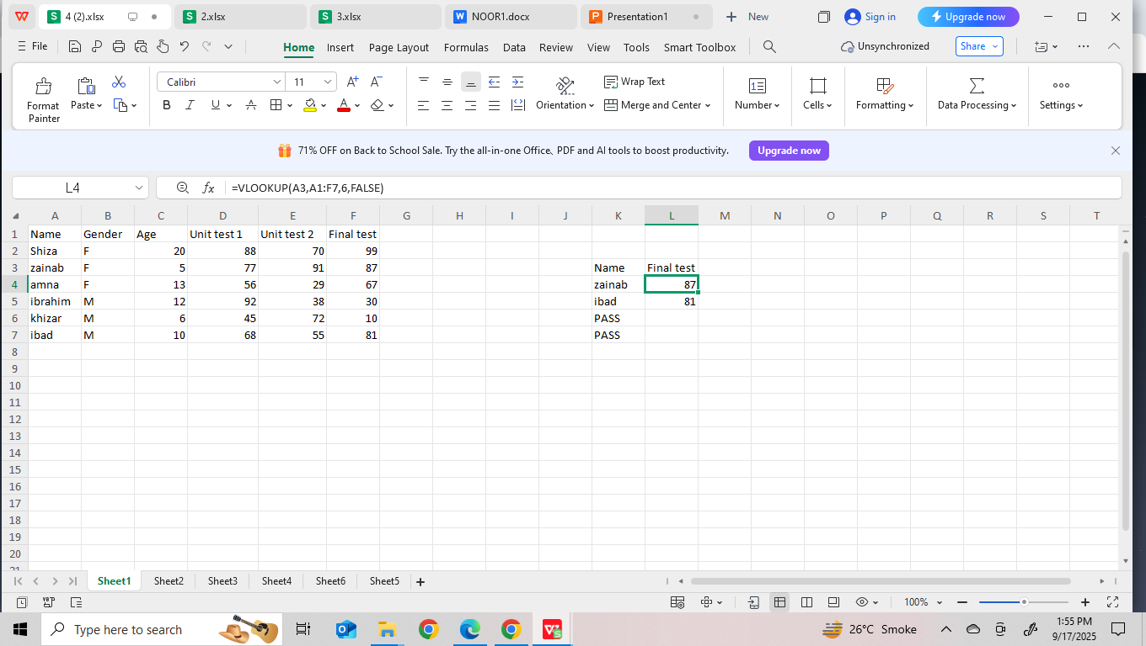
VLOOKUP IN EXCEL
VLOOKUP is a very powerful tool in excel which is use to see things quickly from a Raw Data.
.

Slide 5
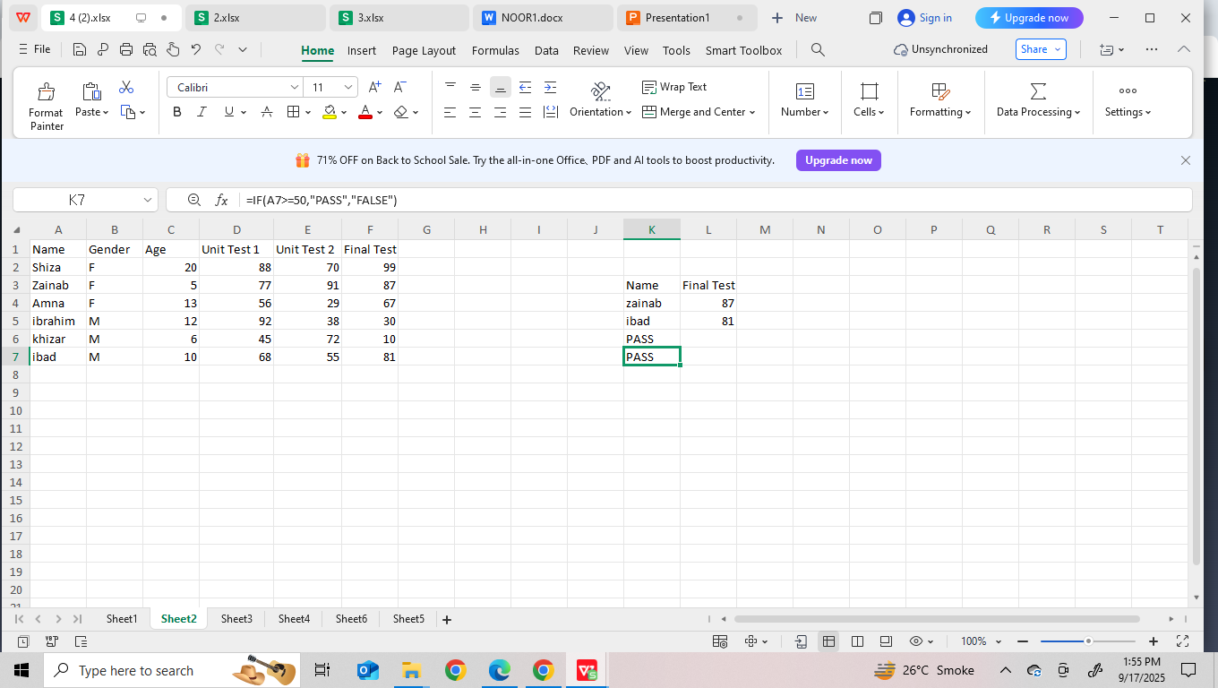
IF FORMULA
The IF formula is used to make logical comparisons between a value and a criteria. It tests a condition and returns one value if the condition is TRUE, and a different value if the condition is FALSE.

Slide 6
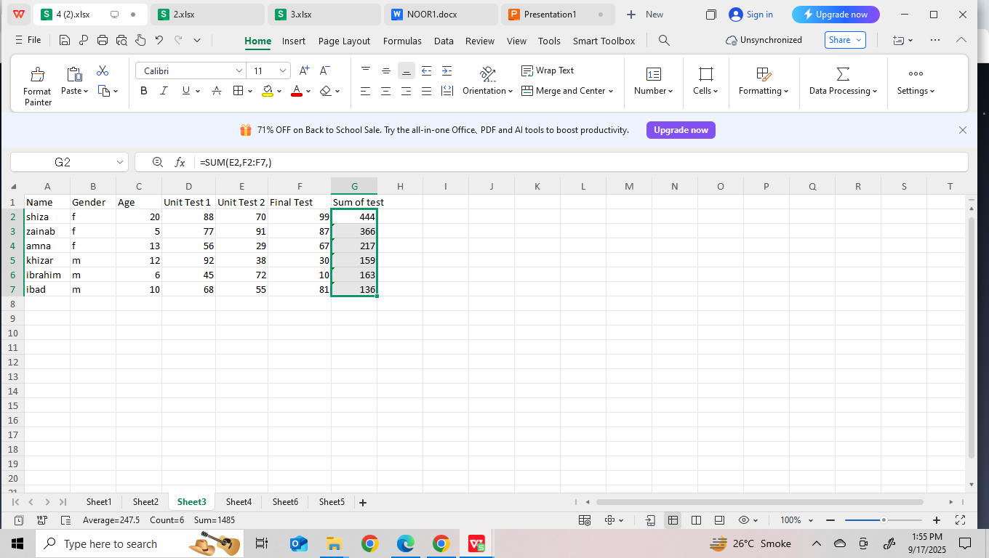
SUM FORMULA
The SUM formula is used to add a range of numbers

Slide 7
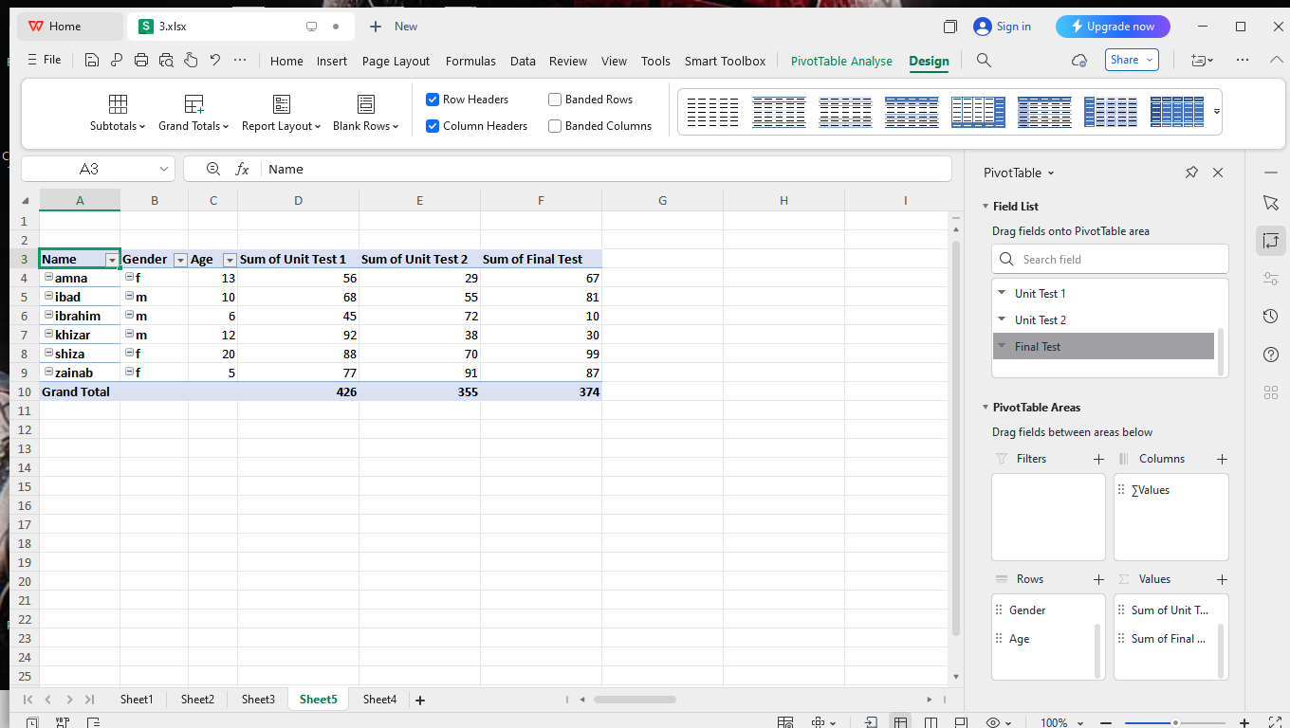
PIVOT TABLE
A PivotTable is a powerful tool Excel and Google Sheets that is used to summarize, analyze, explore, and present large datasets in a more manageable and meaningful way

Slide 8
Thank You.

